Slide 2
Implementing a Linked List in C++

Slide 3
Introduction to Linked List
Definition: A linked list is a linear data structure that consists of a sequence of elements called nodes, where each node contains two parts:

Slide 4
Introduction to Linked List
Definition: A linked list is a linear data structure that consists of a sequence of elements called nodes, where each node contains two parts:
Data: The value or information stored in the node.

Slide 5
Introduction to Linked List
Definition: A linked list is a linear data structure that consists of a sequence of elements called nodes, where each node contains two parts:
Data: The value or information stored in the node.
Pointer (or Link): A reference to the next node in the sequence.

Slide 6
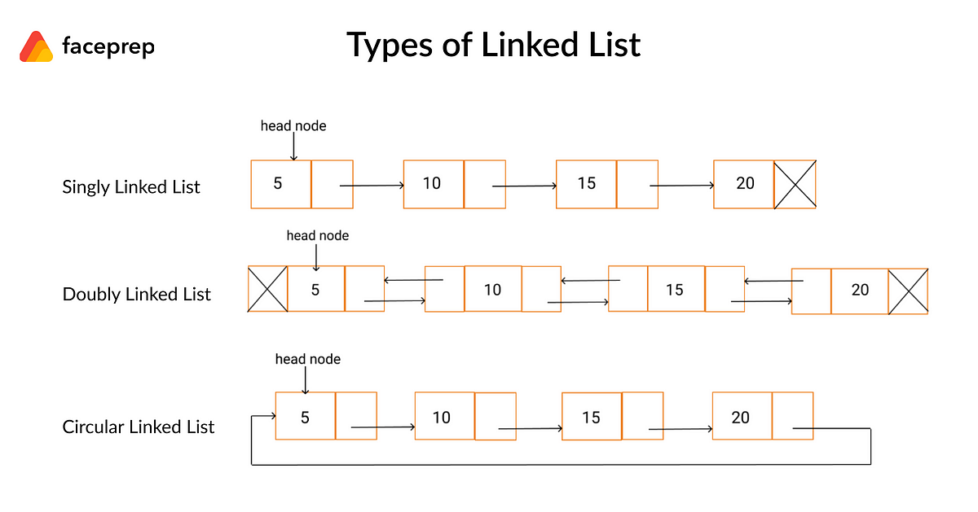
Introduction to Linked List
Definition: A linked list is a linear data structure that consists of a sequence of elements called nodes, where each node contains two parts:
Data: The value or information stored in the node.
Pointer (or Link): A reference to the next node in the sequence.

Slide 7
Introduction to Linked List
Definition: A linked list is a linear data structure that consists of a sequence of elements called nodes, where each node contains two parts:
Data: The value or information stored in the node.
Pointer (or Link): A reference to the next node in the sequence.

Slide 8
Introduction to Linked List
Definition: A linked list is a linear data structure that consists of a sequence of elements called nodes, where each node contains two parts:
Data: The value or information stored in the node.
Pointer (or Link): A reference to the next node in the sequence.

Slide 9
Singly Linked List

Slide 10
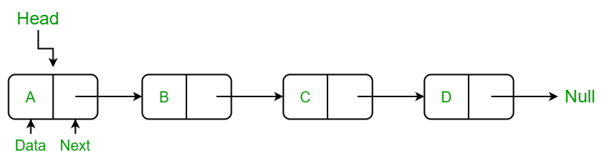
Singly Linked List
Each node points to the next node in the list.

Slide 11
Singly Linked List
Each node points to the next node in the list.
It allows traversal in one direction (forward).

Slide 12
Singly Linked List
Each node points to the next node in the list.
It allows traversal in one direction (forward).
The last node points to null, indicating the end of the list.

Slide 13
How to create an array?

Slide 14
How to create an array?
int myArray[5]; // Declares an integer array of size 5

Slide 15
How to create an array?
int myArray[5]; // Declares an integer array of size 5
int myArray[5] = {1, 2, 3, 4, 5}; // Initializes with values

Slide 16
How to create an array?
int myArray[5]; // Declares an integer array of size 5
int myArray[5] = {1, 2, 3, 4, 5}; // Initializes with values
int size = 10;
int* dynamicArray = new int[size]; // Creates a dynamic array of size 10

Slide 17
Why Can’t We Create a Singly Linked List like arrays?

Slide 18
Why Can’t We Create a Singly Linked List like arrays?
C++ provides many standard data structures in the STL

Slide 19
Why Can’t We Create a Singly Linked List like arrays?
C++ provides many standard data structures in the STL
Array
Vector
List
Map

Slide 20
Why Can’t We Create a Singly Linked List like arrays?
C++ provides many standard data structures in the STL
Array
Vector
List
Map
It does not include a singly linked list specifically.

Slide 21
So how to create Singly Linked List in C++?

Slide 22
So how to create Singly Linked List in C++?
Creating a Custom Data Structure in C++

Slide 23
So how to create Singly Linked List in C++?
Creating a Custom Data Structure in C++
Define the Data Structure's Purpose and Requirements

Slide 24
So how to create Singly Linked List in C++?
Creating a Custom Data Structure in C++
Define the Data Structure's Purpose and Requirements
Choose a Data Representation

Slide 25
So how to create Singly Linked List in C++?
Creating a Custom Data Structure in C++
Define the Data Structure's Purpose and Requirements
Choose a Data Representation
Design the Node Structure

Slide 26
So how to create Singly Linked List in C++?
Creating a Custom Data Structure in C++
Define the Data Structure's Purpose and Requirements
Choose a Data Representation
Design the Node Structure
Create the Main Data Structure Class

Slide 27
So how to create Singly Linked List in C++?
Creating a Custom Data Structure in C++
Define the Data Structure's Purpose and Requirements
Choose a Data Representation
Design the Node Structure
Create the Main Data Structure Class
Implement Core Operations

Slide 28
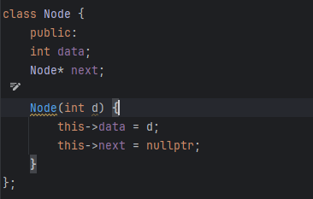
Design the Node Structure

Slide 29
Example of Node
1
Pointer
nullptr

Slide 30
Example of Node
1
Pointer
nullptr

Slide 31
Example of Node
1
Pointer
2
Pointer
nullptr

Slide 32
Example of Node
1
Pointer
2
Pointer
nullptr

Slide 33
Example of Node
1
Pointer
2
Pointer
nullptr

Slide 34
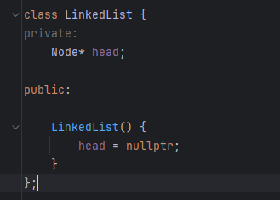
Create the Main Data Structure Class (Linked List)

Slide 35
Empty Linked List
Head
nullptr

Slide 36
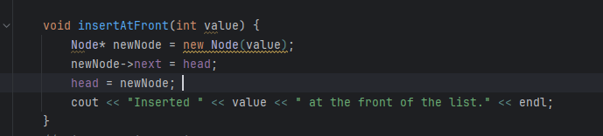
Core Operations (Insertion at Beginning)

Slide 37
Empty Linked List
Head
nullptr

Slide 38
Create Node
1
Pointer

Slide 39
Make Node point where was point before
1
Pointer
nullptr

Slide 40
Give head the address of new node
Head
1
Pointer
nullptr

Slide 41
Create Another Node
2
Pointer
Head
1
Pointer
nullptr

Slide 42
Make Node point where head was pointing before
Head
2
Pointer
1
Pointer
nullptr

Slide 43
Give head the address of new node
Head
2
Pointer
1
Pointer
nullptr

Slide 44
Bonus Work

Slide 45
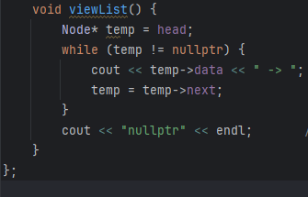
Viewing List

Slide 46
Tasks
In class
Create 3 empty linked lists and print them
Add one Element to each Linked List and print them
Add three more nodes to linked list and print them
Home Work
Implement insert to the end function in given class.

